Slide 1


Andres Salamone Lacunza
23/05/2025

Slide 2
Outline / Indice
Summary (Resumen).
Introduction (Introducción).
Methodology (Metodología).
Results (Resultados).
Conclusion (Conclusión).
Appendix (Apéndice).

Slide 3
Methodology
Data was collected about the Falcon 9 first stage landings from 2010 to 2020 from a public API (https://api.spacexdata.com/) unaffiliated with SpaceX and from the publically available data on Wikipedia (https://en.wikipedia.org/wiki/SpaceX). Additional data sets were provided with the course.
Data cleaning / wrangling included extracting landing outcome data to serve as the dependent variable for the machine learning models.
SQL queries and data visualizations, including static plots, interactive maps, and an interactive dashboard, were used to discover insights about the data set and to answer various questions.
Predictive analysis was performed using the following machine learning models: Logistic Regression, Support Vector Machine (SVM), Decision Tree, and k-Nearest Neighbors (KNN)
Results
The data of the SpaceX Falcon 9 first stage landings include the flight number, date of launch, payload mass, orbit type, launch site, and mission outcome.
Logistic Regression, SVM, and KNN all performed equally well on this dataset for predictive purposes.
Summary

Slide 4

Introduction
In competition with SpaceX, a rival rocket launch company wants to make predictions about the success of SpaceX Falcon 9 rocket first stage landings.
Questions to explore:
What is the nature and extent of the available data about SpaceX Falcon 9 first stage landings?
Which machine learning model would work best (have the highest accuracy) to predict the outcome of a Falcon 9 first stage landing from a future launch?
Will a future Falcon 9 first stage landing be successful?

Slide 5


Slide 6

Methodology
1. Data Collection & Processing:
Collected data from a public API, a Wikipedia article, and course-provided CSV files.
Performed data wrangling, cleaning, and transformation for analysis readiness.
2. Exploratory Data Analysis (EDA):
Conducted comprehensive EDA using data visualizations (e.g., patterns, outliers) and SQL queries for in-depth data exploration.
3. Interactive Visual Analytics:
Created dynamic interactive visualizations with Folium (geospatial) and Plotly Dash (interactive dashboards) for user-driven insights.
4. Predictive Analysis & Model Evaluation:
Developed and tuned classification models (machine learning models) for predictive analysis.
Evaluated performance using key metrics like Accuracy, Precision, Recall, F1-Score, and ROC AUC.

Slide 7
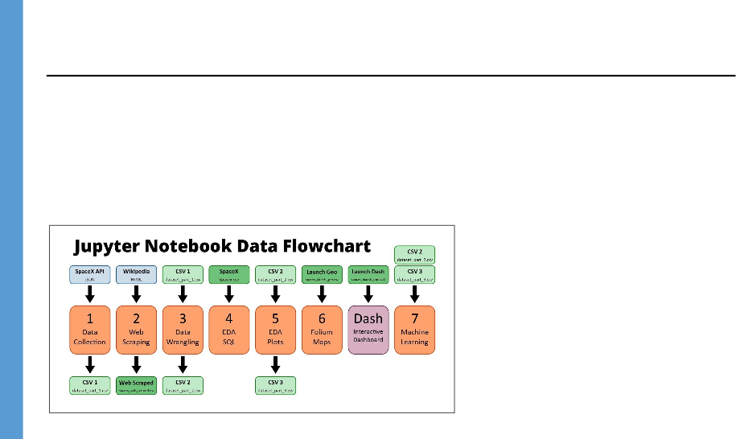
Data Collection
The data sets were collected from:
An IBM copy of a response from a publically accessible API with launch data in JSON format.
A permanently-linked Wikipedia page with launch data in HTML tables (9 June 2021 revision).
Additional data sets were provided with the course in CSV file format (Highlighted as the darker green CSV files in the top row of the diagram below). See appendix for links.

Slide 8

Data Collection – SpaceX API
SpaceX data was available publically at the API endpoint: https://api.spacexdata.com/
Note: This API is not affiliated with SpaceX.
A copy of the response from this API was made available for the purposes of this project. See appendix for link.
Data was extracted from the response from the API and loaded into a Pandas DataFrame for further analysis.
GitHub URL (Data Collection):
Proyect Andylifeguard Capstone - SpaceX
Flowchart of SpaceX API Data Processing
Send GET request to API
Extract nested data
Convert date format
Use defined functions to generate specific columns of data
Combine separate columns into a DataFrame
Filter out all launches with rockets other than the Falcon 9
Handle missing values

Slide 9
Data Collection - Scraping
SpaceX launch data was scraped from HTML tables on a permanently-linked copy of the SpaceX Wikipedia webpage (https://en.wikipedia.org/wiki/SpaceX).
Launch data was extracted from these tables and loaded into a Pandas DataFrame for further analysis.
GitHub URL (Web Scraping):
Flowchart of web scraping
Web Scrape the page to get the entire HTML text
Create a BeautifulSoup object from the response text content
Select the tables
From the launch table, extract the column names from the <th></th> tags
Create a Pandas DataFrame by parsing the launch tables

Slide 10
The CSV file from the first section contained the data in need of cleaning/wrangling.
The launch sites, orbit types and mission outcomes were processed and reformatted.
The mission outcome types were converted to a binary classification (one- hot encoding) where 1 represented the Falcon 9 first stage landing being a success and 0 represented a failure.
The new mission outcome classification column was added to the DataFrame.
GitHub URL (Data Wrangling):
Flowchart of Data Cleaning / Wrangling
Load data from CSV file from earlier
Find the number of launches at each site
Find the quantity of each type of orbit
Find the quantity of each type of mission outcome
Create a DataFrame column from the mission
outcome data
Compile data into a single DataFrame
Data Wrangling

Slide 11
EDA with Data Visualization
The following charts were created to look at Launch Site trends
Scatterplot to see mission outcome relationship split by Launch Site and Flight Number.
Scatterplot to see mission outcome relationship split by Launch Site and Payload.
The following charts were created to look at Orbit Type trends
Bar chart to see mission outcome relationship with Orbit Type.
Scatterplot to see mission outcome relationship split by Orbit Type and Flight Number.
Scatterplot to see mission outcome relationship split by Orbit Type and Payload.
The following chart was created to look at trends based on time
Line plot to see mission outcome trend by year.
GitHub URL (EDA with Data Visualization):

Slide 12
EDA with SQL
SQL queries were written to extract information about:
Launch sites
Payload masses
Dates
Booster types
Mission outcomes
GitHub URL (EDA with SQL):

Slide 13
Map objects were created and added to the Folium map
Markers were added for launch sites and for the NASA Johnson Space Center
Circles were added for the launch sites.
Lines were added to show the distance to the nearby features:
Distance from CCAFS LC-40 to the coastline
Distance from CCAFS LC-40 to the rail line
Distance from CCAFS LC-40 to the perimeter road
GitHub URL (Folium Maps):
Interactive Map with Folium

Slide 14
The Plotly Dash dashboard included a dropdown input to select data from ‘one’ or
‘all’ launch sites to display on the pie chart and scatterplot.
For ‘one’ launch site, the pie chart displayed the distribution of successful and failed Falcon 9 first stage landings for that site.
For ‘all’ launch sites, the pie chart displayed the distribution of successful Falcon 9
first stage landings between the sites.
The input slider is used to filter the payload masses for the scatterplot.
The scatterplot displayed the distribution of Falcon 9 first stage landings split by payload mass, mission outcome and by booster version category.
GitHub URL (Dashboard File):
Dashboard with Plotly Dash

Slide 15
The dataset was split into training and testing sets.
The following machine learning models were trained on
The training data set:
Logistic Regression
SVM (Support Vector Machine)
Decision Tree
KNN (k-Nearest Neighbors)
Hyper-parameters were evaluated using GridSearchCV() and the best was selected using the best_params method.
Using the best hyper-parameters, each of the four models were scored on accuracy by using the testing data set.
GitHub URL (Machine Learning):
Flowchart of Machine Learning
The Pandas DataFrame was created from the cleaned data
The data was split into training and
testing sets
Each of the four models were trained
on the training data set
Each of the four models were
evaluated on the testing data set
Models were compared based on accuracy scores
Predictive Analysis (Classification)

Slide 16
Results
Insights Drawn from EDA (Exploratory Data Analysis)
Exploratory Data Analysis – Data Visualizations
Exploratory Data Analysis – SQL Queries
Launch Sites Proximities Analysis
Interactive Folium Maps (Screenshots)
Build a Dashboard with Plotly Dash
Interactive Plotly Dash Dashboard (Screenshots)
Predictive Analysis (Classification)
Predictive Analysis (Classification) – Machine Learning

Slide 17

Section 2

Slide 18
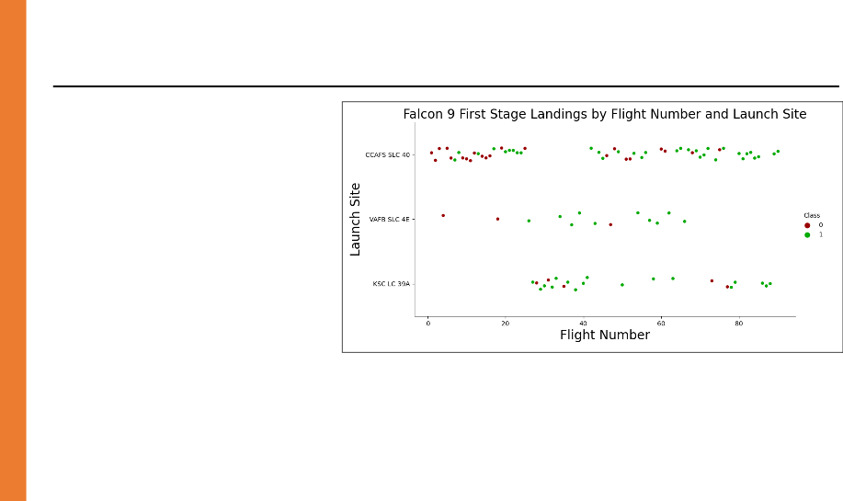
Flight Number vs. Launch Site
Success rate varied
noticeably with launch site.
Successful Falcon 9 first stage landings appear to become more prevalent as the flight number increases
Falcon 9 first stage failed landings are indicated by the ‘0’ Class (● red markers) and successful landings by the ‘1’ Class (● green markers).

Slide 19
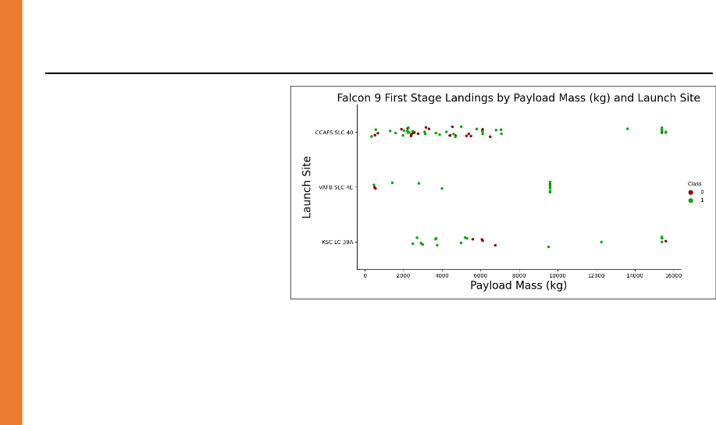
Payload vs. Launch Site
For the CCAFS SLC 40 launch site, the payload mass and the landing outcome appear to not be strongly correlated.
The failed landings at the KSC LC 39A launch site are mostly grouped around a narrow band of payload masses.
Falcon 9 first stage failed landings are indicated by the ‘0’ Class (● red markers) and successful landings by the ‘1’ Class (● green markers).

Slide 20
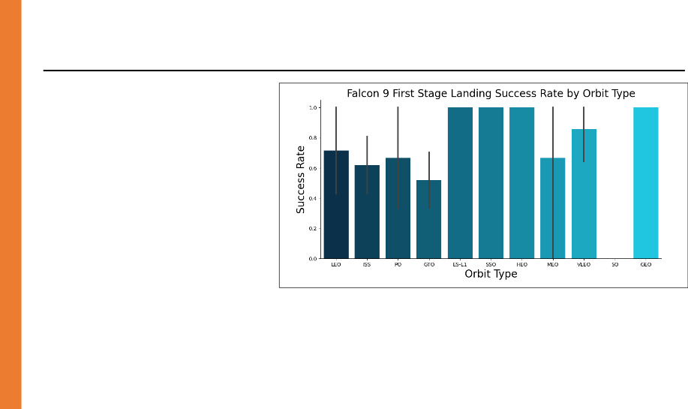
Success Rate vs. Orbit Type
ES-L1, SSO, HEO and GEO
orbits have no failed first
stage landings.
SO orbits have no successful first stage landings.

Slide 21
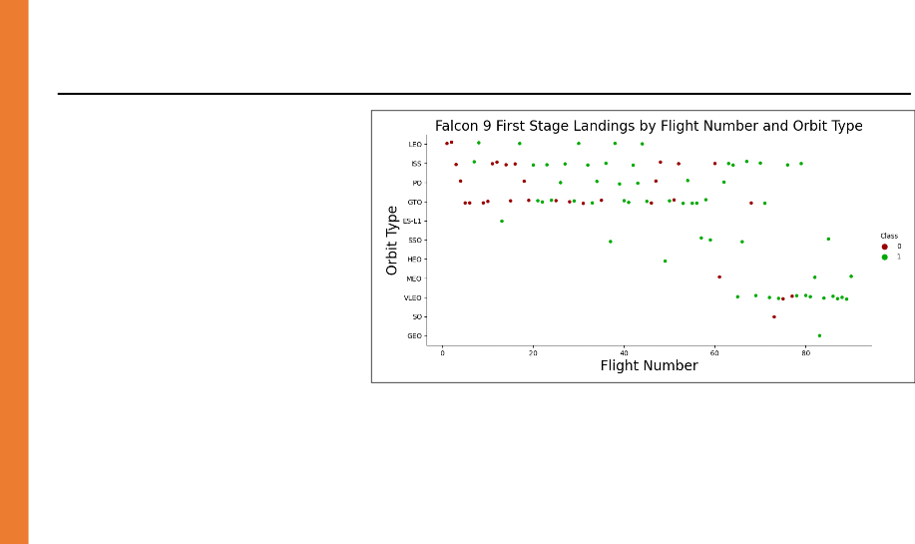
There is a positive correlation between flight number and success rate. (I.e. Larger flight numbers were associated with higher success rates.)
Flight Number vs. Orbit Type

Slide 22
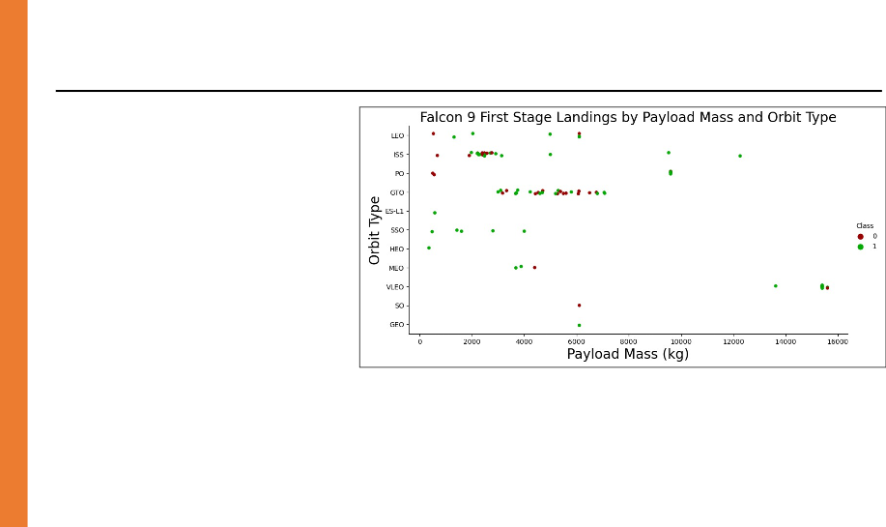
Payload vs. Orbit Type
Some orbit types showed higher success rates than others.
Success rate appeared to have no obvious correlation with payload mass.

Slide 23
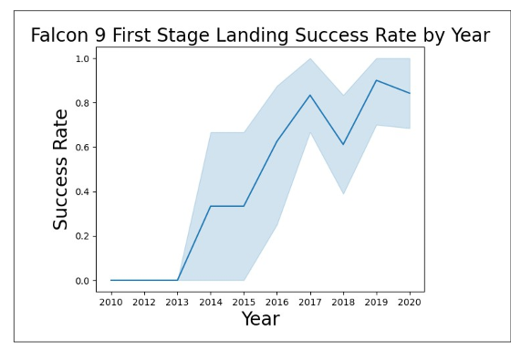
Launch Success Yearly Trend
The success rate of the Falcon 9 first stage landings has increased significantly over the selected interval of years.

Slide 24
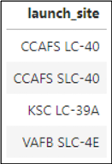
All Launch Site Names
Question: What are the names of the unique launch sites?
Query: SELECT DISTINCT `LAUNCH_SITE` FROM `SPACEXDATASET`;
Result: CCAFS LC-40,CCAFS SLC-40, KSC LC-39A, VAFB SLC-4E.
Explanation: There are four unique launch sites.

Slide 25
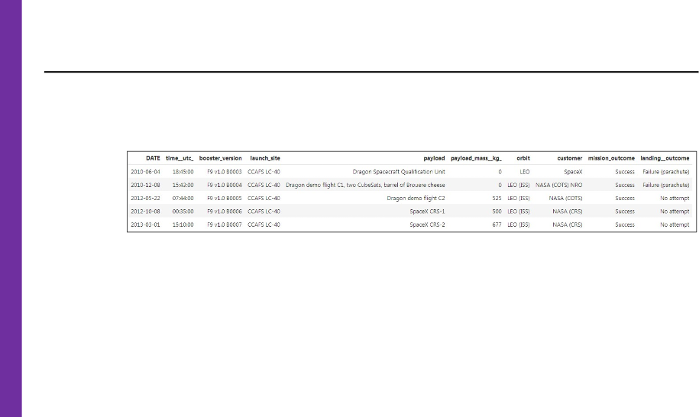
Launch Site Names Begin with 'CCA'
Task: Find 5 records with launch sites that begin with `CCA`.
Query: SELECT * FROM `SPACEXDATASET` WHERE `launch_site` LIKE 'CCA%' LIMIT 5;
Result:
Explanation: This is a fairly straightforward sampling mechanism used to gain a sense of the data contained in the database table.

Slide 26
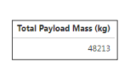
Total Payload Mass
Question: What is the total payload carried by boosters from NASA?
Query: SELECT sum(`payload_mass kg_`) AS "Total Payload Mass (kg)" FROM `SPACEXDATASET` WHERE `customer` LIKE '%NASA (CRS)%';
Result: Total Payload Mass(kg) = 48213.
Explanation: The total payload carried by boosters from NASA is 48,213 kg.

Slide 27
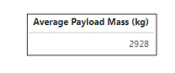
Average Payload Mass by F9 v1.1
Question: What is the average payload mass carried by booster version F9 v1.1?
Query: SELECT sum(`payload_mass kg_`) / count(`payload_mass kg_`) AS “Average Payload Mass (kg)" FROM `SPACEXDATASET` WHERE `booster_version` LIKE 'F9 v1.1';
Result: Average Payload Mass (kg) = 2929.
Explanation: The average payload mass carried by booster version F9 v1.1 is 2,928 kg.

Slide 28
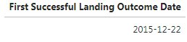
First Successful Ground Landing Date
Question: On which date did the first successful landing outcome on ground pad Occur?
Query: SELECT min(`DATE`) AS "First Successful Landing Outcome Date" FROM `SPACEXDATASET` WHERE `landing outcome` LIKE ‘Success (ground pad)';
Result:
Explanation: The first successful landing outcome on ground pad occurred on December 22, 2015.

Slide 29

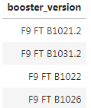
Question: What are the names of the boosters which have successfully landed on drone ship and had a payload mass greater than 4000 but less than 6000?
Query: SELECT DISTINCT `booster_version` FROM `SPACEXDATASET` WHERE `landing outcome` = 'Success (drone ship)' AND `payload_mass kg_` BETWEEN 4000 AND 6000;
Result:
Explanation: The four booster versions that have successfully landed on drone ship with a payload mass greater than 4,000 kg but less than 6,000 kg are listed above.
Successful Drone Ship Landing with Payload between 4000 and 6000

Slide 30
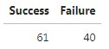
Total Number of Successful and Failure Mission Outcomes
Question: What was the total number of successful and failed mission outcomes?
Query: SELECT (SELECT count(*) FROM `SPACEXDATASET` WHERE lcase(`landing outcome`) LIKE '%success%') AS "Success“, count(*) AS "Failure" FROM `SPACEXDATASET` WHERE lcase(`landing outcome`) NOT LIKE '%success%';
Result:
Explanation: There were 61 successful and 40 failed mission outcomes.

Slide 31
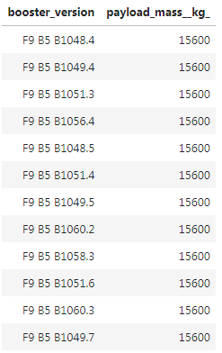
Question: What were the names of the boosters which have carried the maximum payload mass?
Query: SELECT `booster_version`, `payload_mass kg_` FROM `SPACEXDATASET` WHERE `payload_mass kg_` = (SELECT max(`payload_mass kg_`) FROM `SPACEXDATASET`);
Result:
Explanation: The maximum payload mass carried in this dataset is 15,600 kg. Twelve (12) separate Falcon 9 boosters carried this amount of payload mass.
Boosters Carried Maximum Payload

Slide 32
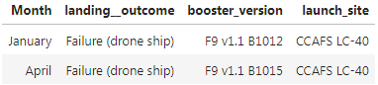
2015 Launch Records
Task: List the failed landing_outcomes in drone ship, their booster versions, and launch site names for records in year 2015.
Query: SELECT MONTHNAME(`DATE`) AS ‘Month’, `landing outcome`, `booster_version`, `launch_site` FROM `SPACEXDATASET` WHERE `landing outcome` = 'Failure (drone ship)' AND YEAR(`DATE`) = 2015;
Result:
Explanation: There were two failed landing outcomes with a drone ship in 2015. Both launched from CCAFS LC-40. One occurred in January and the other in April.

Slide 33
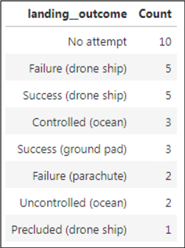
Rank Landing Outcomes Between 2010-06-04 and 2017-03-20
Task: Rank the count of landing outcomes (such as Failure (drone ship) or Success (ground pad)) between the date 2010-06-04 and 2017-03-20, in descending order.
Query: SELECT `landing outcome`, count(`landing outcome`) AS ‘Count’ FROM `SPACEXDATASET` WHERE `DATE` BETWEEN '2010-06-04' AND '2017-03-20' GROUP BY `landing outcome` ORDER BY count(`landing outcome`) DESC;
Result:
Explanation: The most common landing outcome was ‘No attempt’.

Slide 34

Section 3

Slide 35
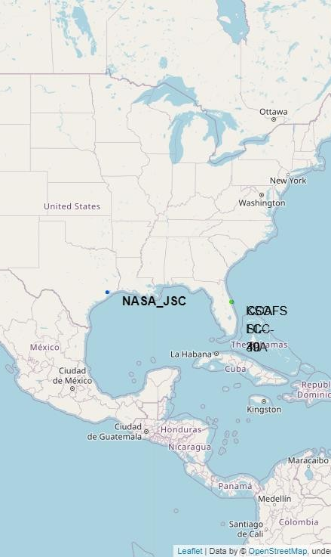
Falcon 9 Launch Site Locations
California, USA.
VAFB SLC-4E | Vandenberg Air Force Base Space Launch Complex 4E.
Florida, USA.
KSC LC-39A | Kennedy Space Center Launch Complex 39A.
CCAFS LC-40 | Cape Canaveral Air Force Station Launch Complex 40.
CCAFS SLC-40 | Cape Canaveral Air Force Station Space Launch Complex 40.
*Note: CCAFS LC-40 and CCAFS SLC-40 in the data refer to the same launch site.

Slide 36
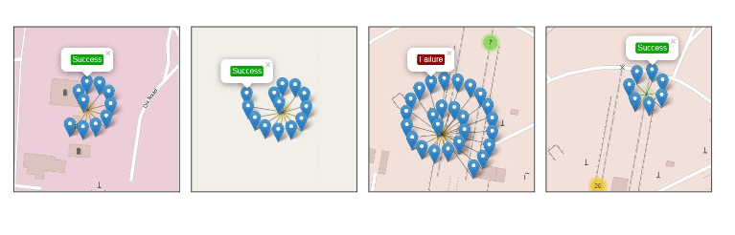
The markers display the mission outcomes (Success/Failure) for Falcon 9 first stage landings. They are grouped on the map to be associated with the geographical coordinates for the launch site.
A sense of a launch site’s success rate for Falcon 9 first stage landings can be gleaned from the relative number of green success markers to red failure markers.
Map Markers of Success/Failed Landings
VAFB SLC-4E
KSC LC-39A
CCAFS LC-40
CCAFS SLC-40

Slide 37
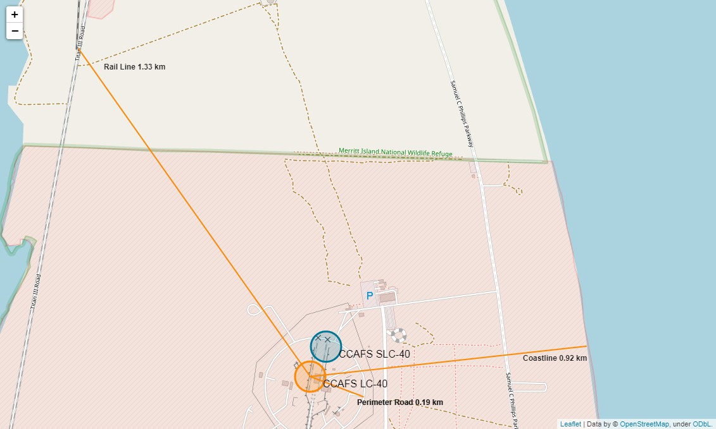
Distance from Launch Site to Proximities
The CCAFS LC-40 and CCAFS SLC-40 launch sites have coordinates that are close to being, but are not exactly, right on top of each other.
The perimeter road around CCAFS LC-40 is 0.19 km away from the launch site coordinates.
The coastline is 0.92 km away from CCAFS LC-40.
The rail line is 1.33 km away from CCAFS LC-40.

Slide 38

Section 4

Slide 39
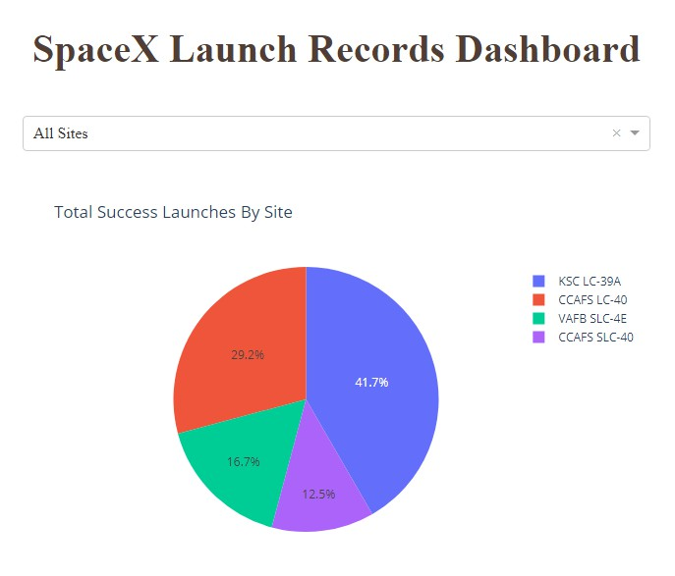
The dropdown menu allowed the selection of one or all launch sites.
With all launch sites selected, the pie chart displayed the distribution of successful Falcon 9 first stage landing outcomes between the different launch sites.
The greatest share of successful Falcon 9 first stage landing outcomes (at 41.7% of the total) occurred at KSC LC-39A.
Launch Success Count for All Sites

Slide 40
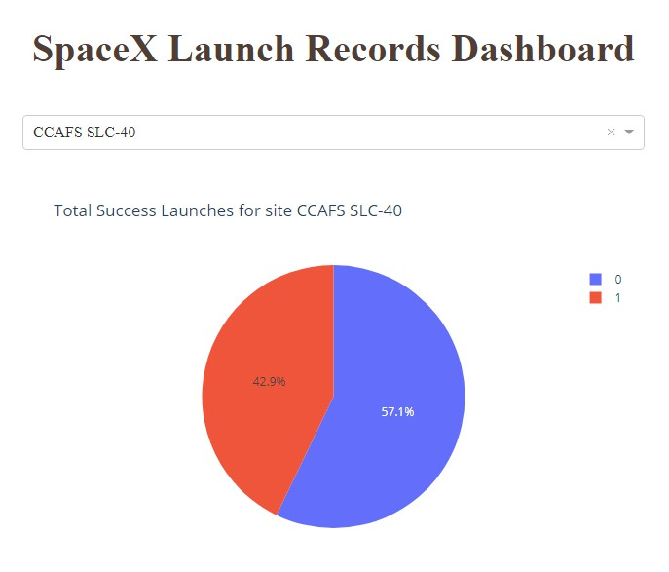
Launch Site with Highest Launch Success Ratio
Falcon 9 first stage failed landings are indicated by the ‘0’ Class (■ blue wedge in the pie chart) and successful landings by the ‘1’ Class (■ red wedge in the pie chart).
CCAFS SLC-40 was the launch site that had the highest Falcon 9 first stage landing success rate (42.9%).

Slide 41
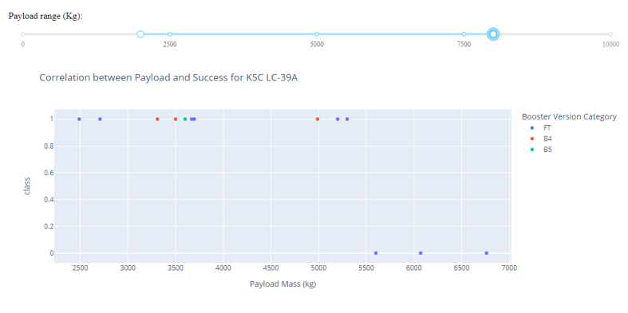
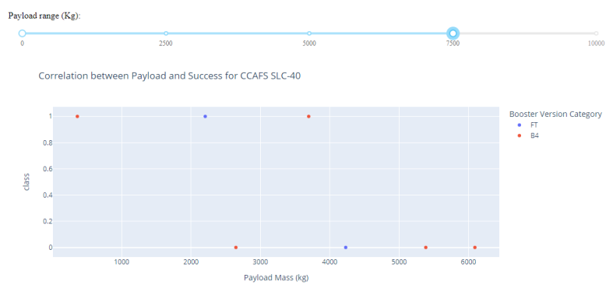
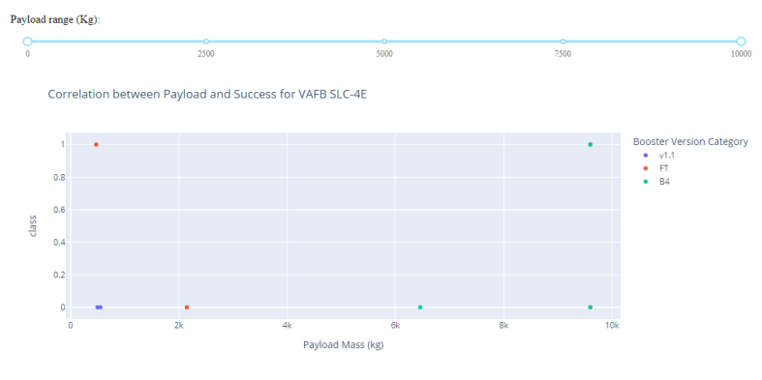
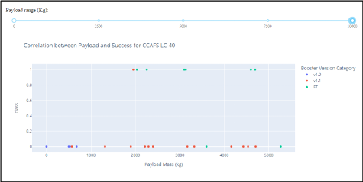
These screenshots are of the Payload vs. Launch Outcome scatter plots for all sites, with different payload selected in the range slider.
The payload range from about 2,000 kg to 5,000 kg has the largest success rate.
The ‘FT’ booster version category has the largest success rate.
Payload vs. Launch Outcome
KSC LC-39A
CCAFS SLC-40
VAFB SLC-4E
CCAFS LC-40​

Slide 42

Section 5

Slide 43
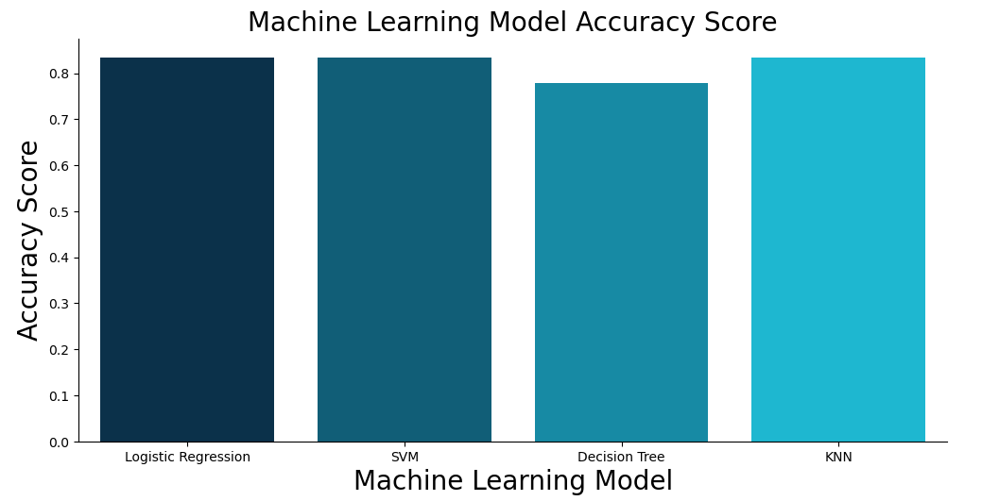
All models performed equally well except for the Decision Tree model which performed poorly relative to the other models.
Classification Accuracy

Slide 44
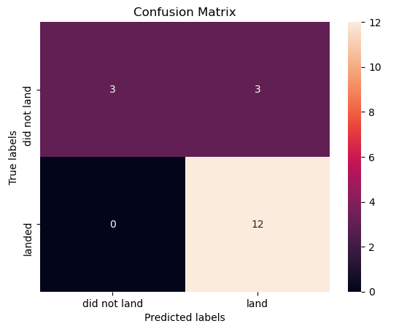

Confusion Matrix
Shown here is the confusion matrix for the Logistic Regression model.
Confusion matrices can be read as:
Prediction Breakdown:
12 True Positives and 3 True Negatives
3 False Positives and 0 False Negatives

Slide 45
Conclusions
SpaceX’s record for Falcon 9 first stage landing outcomes has improved.
The trend is toward better performance and greater success as more launches are made.
The machine learning models can be used to predict future SpaceX Falcon 9 first stage landing outcomes.

Slide 46
Appendix
Initial Data Sources
SpaceX API (JSON): https://cf-courses-data.s3.us.cloud-object-storage.appdomain.cloud/IBM-DS0321EN-SkillsNetwork/datasets/API_call_spacex_api.json
Wikipedia (Webpage): https://en.wikipedia.org/w/index.php?title=List_of_Falcon_9_and_Falcon_Heavy_launches&oldid=1027686922
SpaceX (CSV): https://cf-courses-data.s3.us.cloud-object-storage.appdomain.cloud/IBM-DS0321EN- SkillsNetwork/labs/module_2/data/Spacex.csv?utm_medium=Exinfluencer&utm_source=Exinfluencer&utm_content=000026UJ&utm_term=10006555&utm_id=NA-SkillsNetwork- Channel-SkillsNetworkCoursesIBMDS0321ENSkillsNetwork26802033-2022-01-01
Launch Geo (CSV): https://cf-courses-data.s3.us.cloud-object-storage.appdomain.cloud/IBM-DS0321EN-SkillsNetwork/datasets/spacex_launch_geo.csv
Launch Dash (CSV): https://cf-courses-data.s3.us.cloud-object-storage.appdomain.cloud/IBM-DS0321EN-SkillsNetwork/datasets/spacex_launch_dash.csv

Slide 47
Processed Data Sets (CSV files)
GitHub URL (CSV 1): https://github.com/Andylifeguard/data-science-capstone/blob/main/dataset_part_1.csv
GitHub URL (Web Scraped): https://github.com/Andylifeguard/data-science-capstone/blob/main/spacex_web_scraped.csv
GitHub URL (CSV 2): https://github.com/Andylifeguard/data-science-capstone/blob/main/dataset_part_2.csv
GitHub URL (SpaceX): https://github.com/Andylifeguard/data-science-capstone/blob/main/Spacex.csv
GitHub URL (CSV 3): https://github.com/Andylifeguard/data-science-capstone/blob/main/dataset_part_3.csv
GitHub URL (Launch Geo): https://github.com/Andylifeguard/data-science-capstone/blob/main/spacex_launch_geo.csv
GitHub URL (Launch Dash): https://github.com/Andylifeguard/data-science-capstone/blob/main/spacex_launch_dash.csv

Slide 48
Jupyter Notebooks and Plotly Dashboard File
GitHub URL (Data Collection): https://github.com/Andylifeguard/data-science-capstone/blob/main/1_Capstone_ASalamoneLacunza_Data_Collection.ipynb
GitHub URL (Web Scraping): https://github.com/Andylifeguard/data-science-capstone/blob/main/2_Capstone_ASalamoneLacunza_Web_Scraping.ipynb
GitHub URL (Data Wrangling): https://github.com/Andylifeguard/data-science-capstone/blob/main/3_Capstone_ASalamoneLacunza_Data_Wrangling.ipynb
GitHub URL (EDA with SQL): https://github.com/Andylifeguard/data-science-capstone/blob/main/4_Capstone_ASalamoneLacunza_EDA_SQL.ipynb
GitHub URL (EDA with Data Visualization): https://github.com/Andylifeguard/data-science-capstone/blob/main/5_Capstone_ASalamoneLacunza_EDA_Data_Visualization.ipynb
GitHub URL (Folium Maps): https://github.com/Andylifeguard/data-science-capstone/blob/main/6_Capstone_ASalamoneLacunza_Launch_Site_Location.ipynb
GitHub URL (Dashboard File): https://github.com/Andylifeguard/data-science-capstone/blob/main/ASalamoneLacunza_spacex_dash_app.py
GitHub URL (Machine Learning): https://github.com/Andylifeguard/data-science-capstone/blob/main/7_Capstone_ASalamoneLacunza_Learning_Prediction.ipynb

Slide 49
Reference
Data Collection
Exploratory Data Analysis – Data Visualizations
Exploratory Data Analysis – SQL Queries
Interactive Folium Maps
Interactive Plotly Dash Dashboard
Predictive Analysis (Classification) – Machine Learning

Slide 50


